Slide 1
Undergraduate Research Opportunities
Emily Lau, Bridget Vincent, Niko Hensley, Jessica Goodheart
Oakley Lab | University of California Santa Barbara
*Last updated: 1/12/21

Slide 2
Contents
Overview: Research Experience for Undergraduates (10 minutes)
What are REUs?
How do I search for them?
Which ones should I apply to?
What are the application components and how can I strengthen my application?
Other undergraduate research opportunities (10 min)
UCSB campus
Non NSF-funded undergraduate research experiences
Post-graduate positions
Science-related jobs
Finding opportunities
Jobs after Graduation (5 min)
Post-baccalaureate programs (5 min)
Q & A

Slide 3
What are REUs?
REUs are research programs (typically held during summer) funded by the National Science Foundation (NSF)
Provides opportunities for undergraduates to work on projects outside of their university!
Essentially paid internships & programs tend to cover housing costs
Great way to broaden your research skills, especially if you are interested in graduate school
They are competitive, try to apply to several programs (I applied to 8-12 programs each year)
Many culminate with a research presentation/symposium
Good opportunity to practice sharing your research!

Slide 4
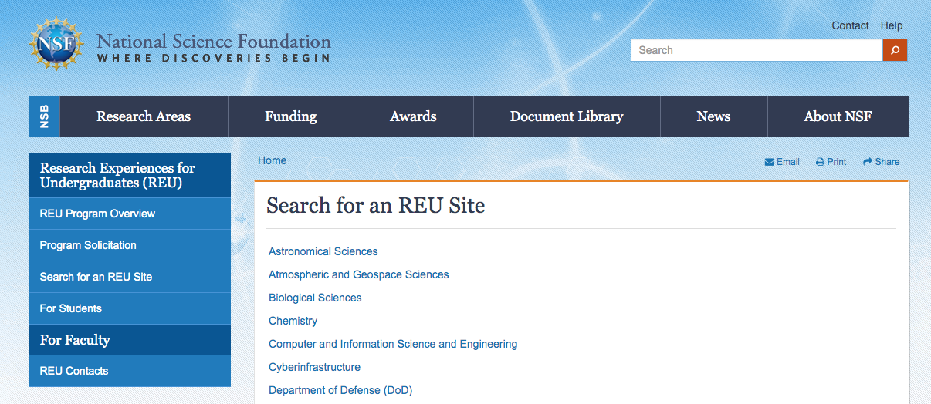

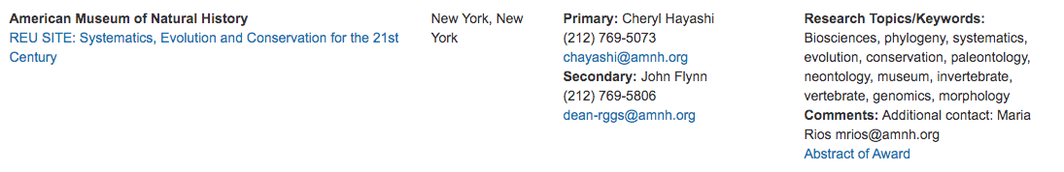
How do I search for REUs?
NSF website “search for REU site” | https://www.nsf.gov/crssprgm/reu/reu_search.jsp
Each program is different, so click on individual links to learn more about the program
Many people advertise REUs on *science* Twitter!
Sometimes advertised through your university
We compiled a list of the biological sciences REU programs, let us know if you do not have a copy!
click here for more info

Slide 5
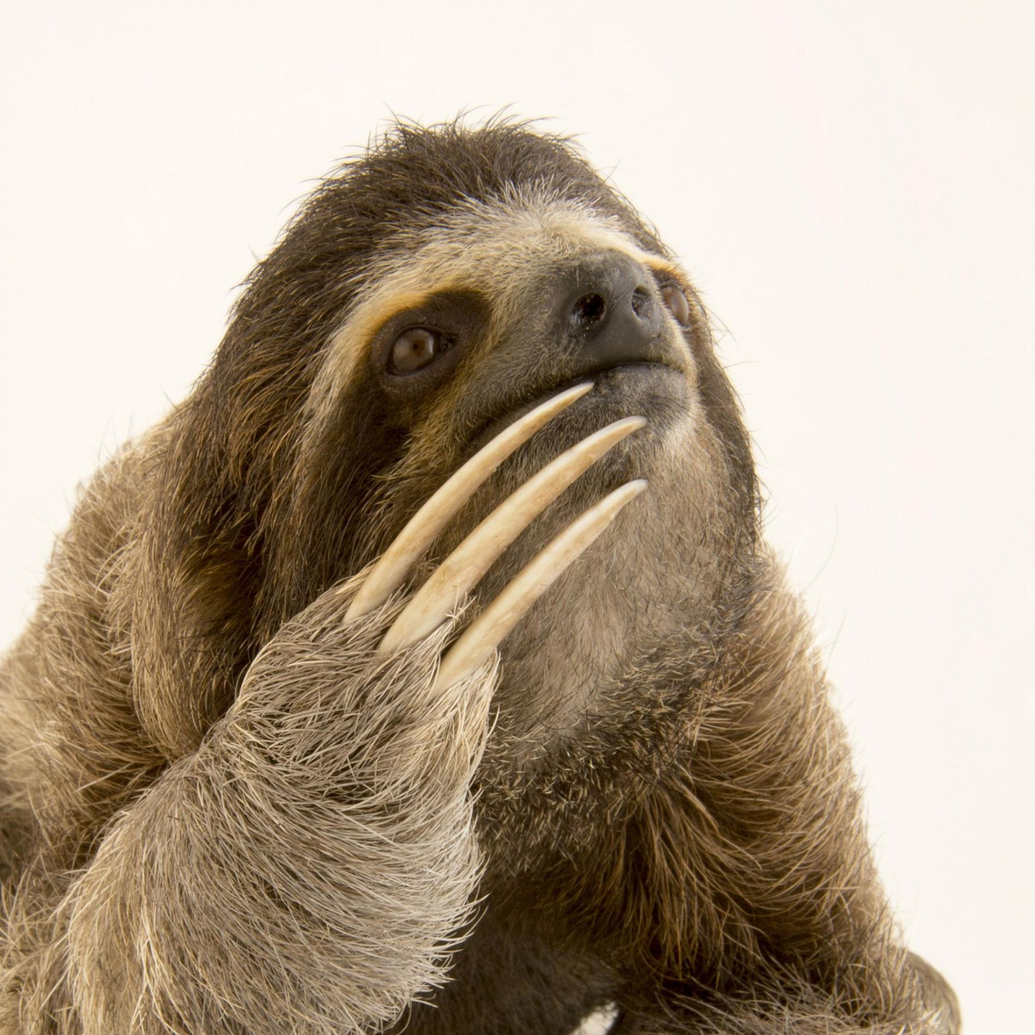
So many REUs, not enough time.. Targeting REUs
Questions to ask yourself before applying
What do I want to learn from participating in a REU?
What skills/lab techniques do I want to develop?
Are there REUs offered at the graduate schools I am interested in?
Are there labs (participating in REUs) that I am interested in?
REUs are quite competitive - thinking about these questions will help strengthen your application
REUs

Slide 6

Application components and tips
Application form & project selection
Statement of interest/research
Previous research experience, academic goals, relevant coursework
Show, not tell! Use examples to demonstrate a generic statement
What are your research interests and how do they fit in with this program?
What skills will you bring to this program/the projects you selected?
How will participating in this program help achieve your goals and advance your academic career?
References (at least 2, sometimes 3!)
Ask recommenders if they can provide a strong letter of rec
Transcript (sometimes unofficial, but they may ask for official!)
Resume/curriculum vitae (CV)
Many universities offer career development services and can help you

Slide 7
REU summary
Amazing, FUNDED opportunities to broaden research skills
Phenomenal way to meet like-minded peers
Useful for thinking about potential graduate schools and prospective research labs
Materials can be co-opted for graduate school applications!
Each program is different, make sure to read their instructions
Each program has their own deadline, requirements, funding information, etc.
Look into programs early, especially since you may need to order official transcripts
Ask potential recommenders if they can write you a strong letter of rec, and ask them early! Deadlines are usually from late January - February
For UC students, some programs will start before spring quarter ends
Look into whether the program will allow you to participate after the quarter ends
Try emailing coordinators to ask - the worst they can say is no!
Twitter provides some great resources: https://miltontan.github.io/links/

Slide 8
Other Undergraduate Research Programs
If you don’t qualify for REUs, it’s okay! There are lots of other opportunities out there to learn, network, and present.
Types of opportunities:
Research at UCSB
Non-NSF Undergraduate Research Experiences: Similar to REUs but might have slightly different benefits, requirements, and take some extra digging
Internships
Post-grad research position: Typically a year or so in length and allow you to work in a different lab and expand your science skill set
Science-related jobs

Slide 9
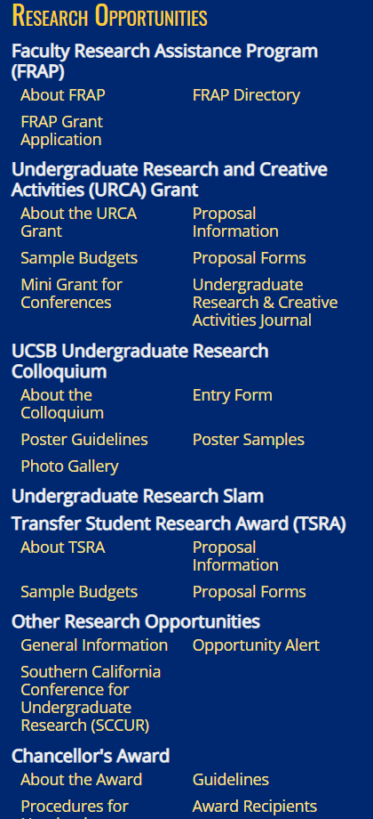
UCSB campus research
You’re already here—congratulations!
If you aren’t at UCF, check your corresponding undergraduate research office for similar resources.
Course credit: Talk to your mentors
Funding opportunities
Undergraduate Research and Creative Studies (URCA) Grant ($750)
Transfer Student Research Award (TRSA) ($750)
CCS Summer Undergraduate Research Fellowship
McNair Scholars Program: underrepresented students
Presentation opportunities (Apply March 1 - April 1)
CCS RACA-CON
UCSB Undergraduate Research Colloquium
Undergraduate Research Slam
URCA mini-grant for virtual presentations outside of UCSB (must be a recipient of URCA) ($250)

Slide 10

Research Programs and Internships
NOT funded by NSF, so they don’t all follow the same rules
These opportunities can take many forms:
Research assistantships, URE (Undergraduate Research Experience), Volunteer positions, research-intensive summer courses
Can offer the same benefits as NSF REUs, BUT these can vary wildly so read the fine print and know what YOU need
Stipend, housing, travel costs?
Related to desired field or builds specific skills?
Current postings:
San Diego Zoo Summer Internship
Consortium for Plant Invasion Genomics
GIS/QGIS training course

Slide 11

Post-Grad Positions
Take place after graduating, before graduate school, vet school, or any position that requires more experience
Short term lab positions
Often lab manager/lab tech type jobs
Designed to help you refine research skills before heading off to your next adventure
Amazing experience for:
Trying your hand at a different field
Expanding your network and learning how other labs function
Learning new skills and sub-fields of science
Living in a new environment (can require travel)
Kelly Dorgan at the Dauphin Island Sea Lab (sediment ecology)
https://polychaetes.weebly.com/
“looking for a highly motivated recent B.S. graduate who is interested in gaining research experience before applying to graduate school.”

Slide 12
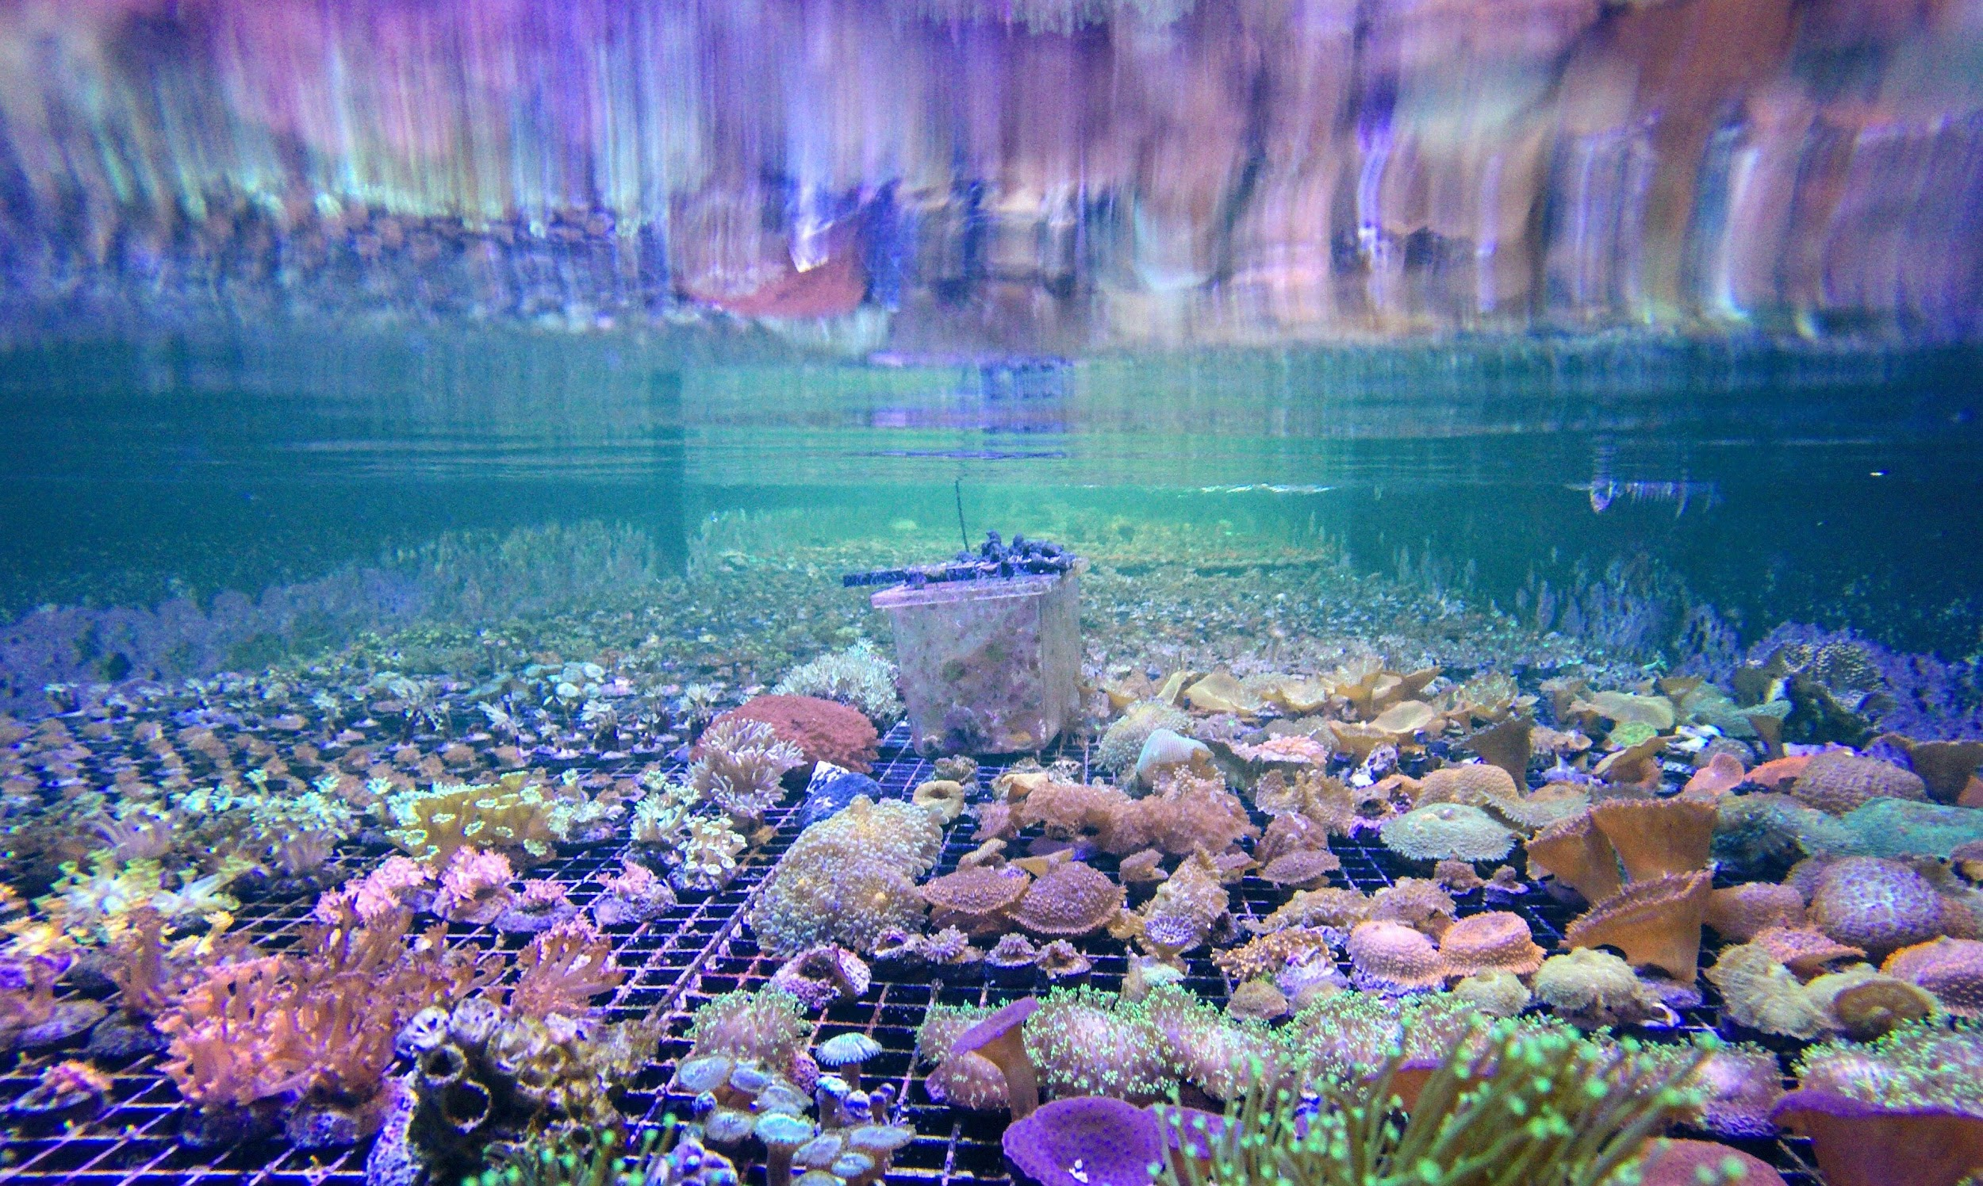
Science-Related Jobs
Fantastic option if you:
Cannot attend an REU
Want to get your feet wet in a specific career
Are interested in a niche job that wouldn’t have a summer program
Need to support yourself long-term
Example from my undergrad days:
Coral aquaculturist for a private business
Learned very specific skills (that still come in handy) and became very familiar with a small sphere of people
Limited for evo bio, but great for those interested in ecology, land management, business, engineering, etc.
Getting started:
Find some organizations you jive with and ask if they have an opening!

Slide 13

Finding Opportunities & Applying
Finding opportunities:
ECOLOG-L listserv
EvolDir directory:
Assoc. Of Zoos and Aquariums job board
Texas A & M Job Board
Science Twitter: follow people whose work interests you!
Institution websites (e.g.: Smithsonian, MBARI, MBL, NOAA, FWC)
LinkedIn (usefulness depends on field)
Applying
Specific requirements vary according to program
General REU guidelines for writing statements, getting letters of rec, etc. still apply!
Campus career services can help you craft materials

Slide 14
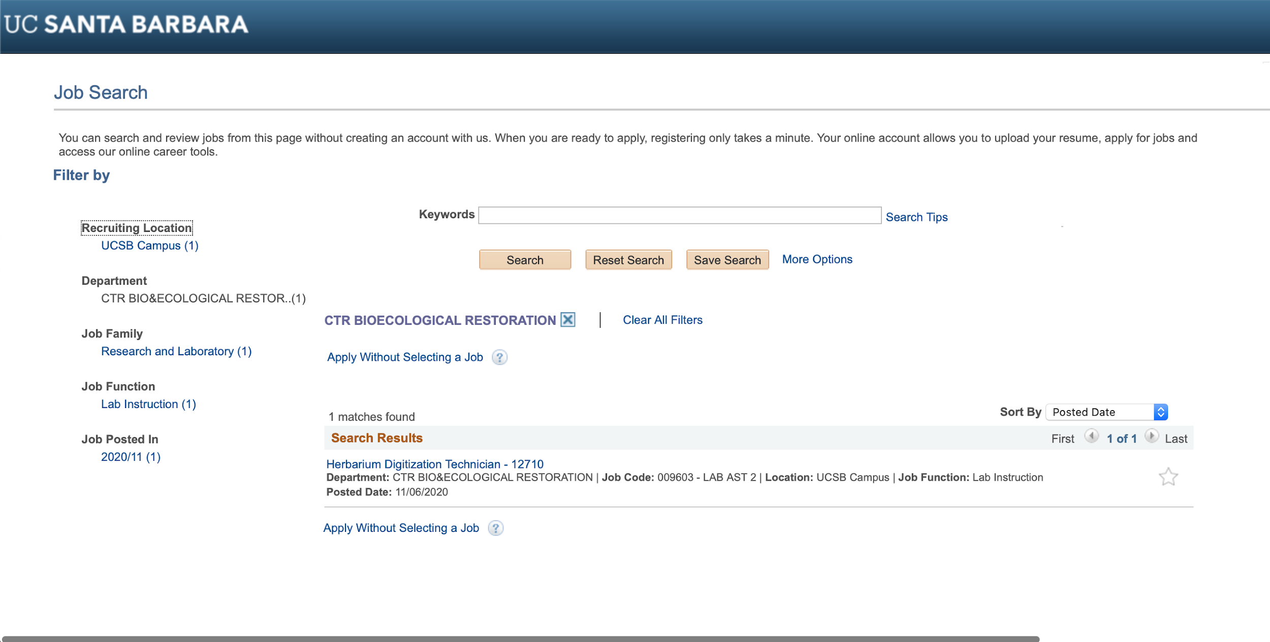
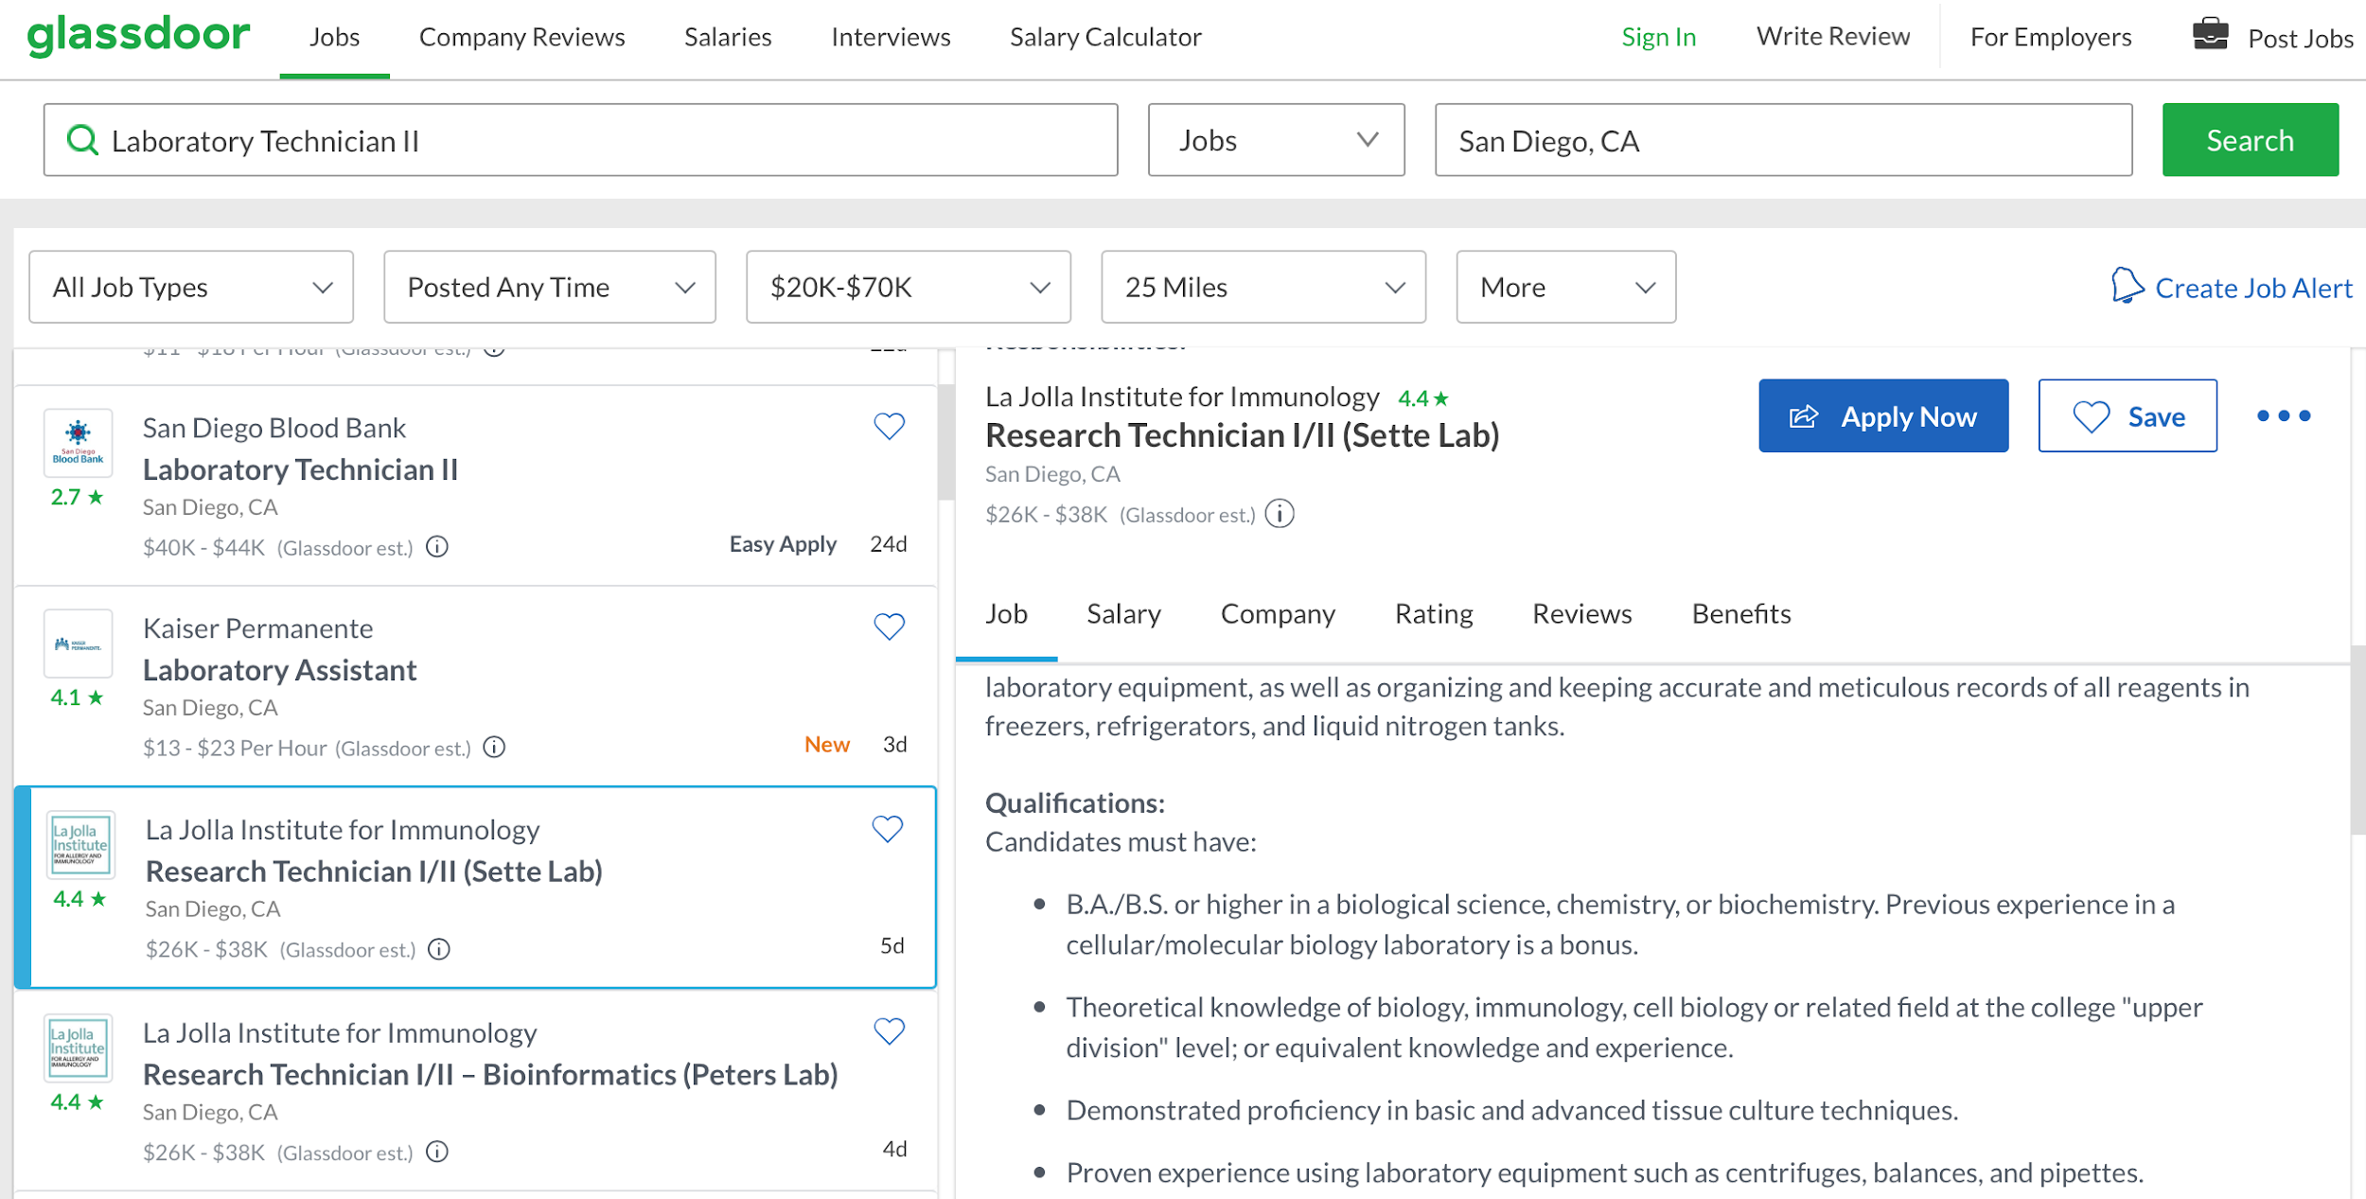
Get a job!
Research doesn’t end when you graduate. You can find many early-career options to continue in science. Most research will be associated with either (1) Universities, (2) companies like tech, biotech, healthcare, etc.
Right out of college, you are looking for entry-level jobs like lab technicians or research technicians. Usually level I or I/II, depending on your level of experience and relevance to the specific job.
Job boards at Universities (https://www.jobs.ucsb.edu), or other (glassdoor, ziprecruiter, indeed.com) will have many listings.

Slide 15
Post-baccalaureate programs
Post-bac programs: Generally designed for college graduates who did not major in the field in which they wish to pursue graduate training
Usually focused on those hoping to attend med school, dental school, etc.
https://www.nigms.nih.gov/maps/Pages/Post-Baccalaureate-Research-Education-Program-Institutions.aspx
Alternative: Masters programs
Pros - involves similar styles of research projects to PhD, 1-3 years, provides additional course opportunities, can apply for different kinds of jobs than with Bachelors (teach as a lecturer @ universities, some consulting jobs, etc.)
Cons - often cost prohibitive (few grants available, tuition remission not always included), is not required for PhD

Slide 16
Form, function, & fit in science
What form of science do I want to participate in? (Research, management, communication, conservation, ...)
This is largely a question of what interests you. Important to take time and figure it out!
What is the function of my role? (Generate products, analyze data, lead projects, educate people, ...)
Determine what motivates your work ethic, and what kind of work satisfaction you need to be healthy and productive. Do you love working with people? Are you driven by the mystery? Know thyself is key here!
Where do I fit into the scientific community?
Everyone has a place and it doesn’t need to be at the graduate level. This is largely something that may be resolved by answering the above questions. Most important is that if you love science, you can find a role that supports your passion!
Resources:
E & E Preview Day: https://eegradpreview.weebly.com/faq.html
Cornell Preview Day: http://www.cornelldpw.org/about.html

Slide 17
Q&A

